Slide 1


QUESTION BREAKDOWN
Genesys Hackathon_JYN

Slide 2
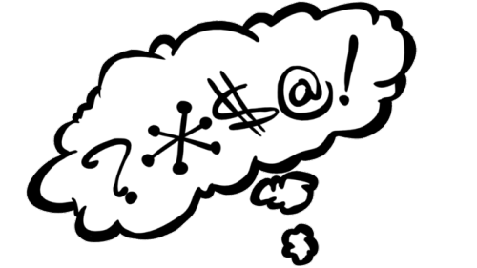

Contents
01. Problem
02. Solution
03. Demonstration
04. Q&A

Slide 3
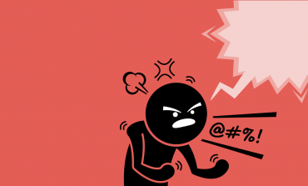
01 PROBLEM

Slide 4
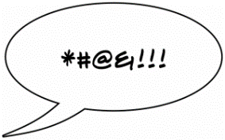



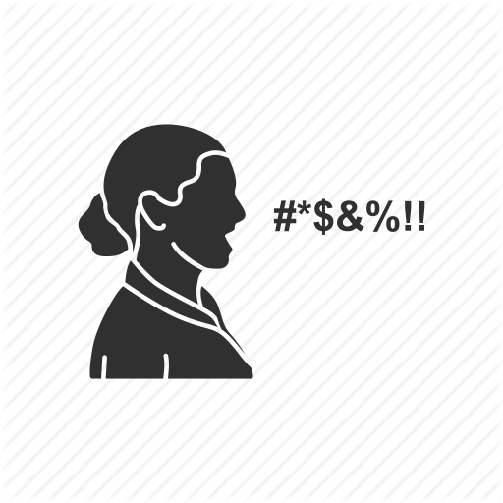


1. PROBLEM
Malicious comments
With the proliferation of smart devices and mobile and social network environments, the social side effects of thetechnologies, including cyberbullying through malicious comments and rumors, have become more serious. Malicious online comments have emerged as an unwelcome social issue worldwide.

Slide 5
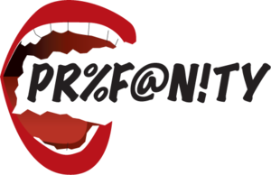
1. PROBLEM – Who’s Fault?
Some Effects of Counselor Profanity in Customer Service
Notes:
60 male and female 24–50 yr old recovering alcoholic counseling clients were assigned randomly to 1 of 3 male counselors and to 1 of 2 treatment conditions. In the nonstandard English condition, the counselor casually and passively introduced 4 profane words. The standard English condition was identical except in respect to the use of these specific words. On client self-report and behavioral measures, which cut across all schools of counseling, counselors who used nonstandard English were judged to be less effective and satisfying. (15 ref) (PsycINFO Database Record (c) 2012 APA, all rights reserved)

Slide 6
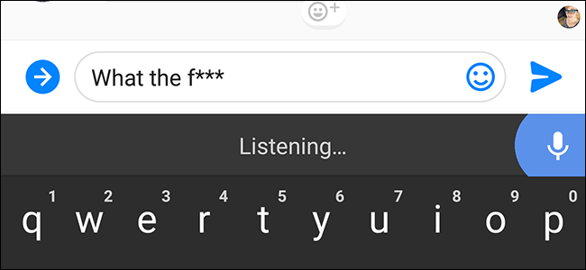
02 SOLUTION

Slide 7
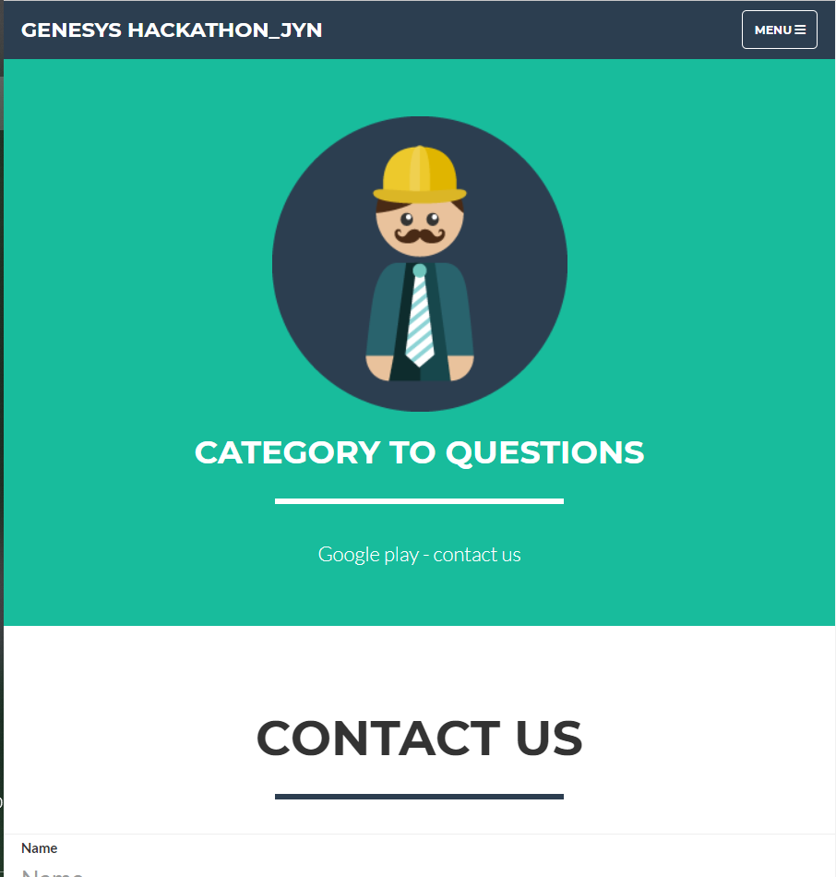
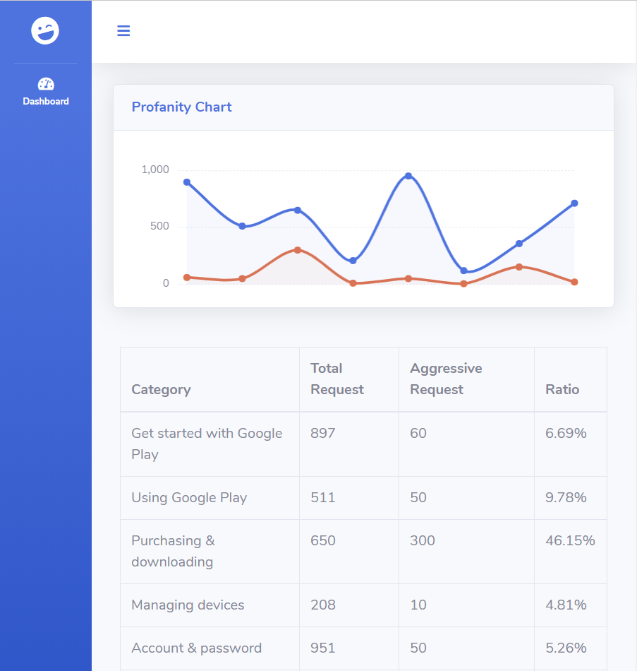
2. SOLUTION
ANALYZE USER REQUEST
CHART & TABLES

Slide 8




2. SOLUTION

Slide 9
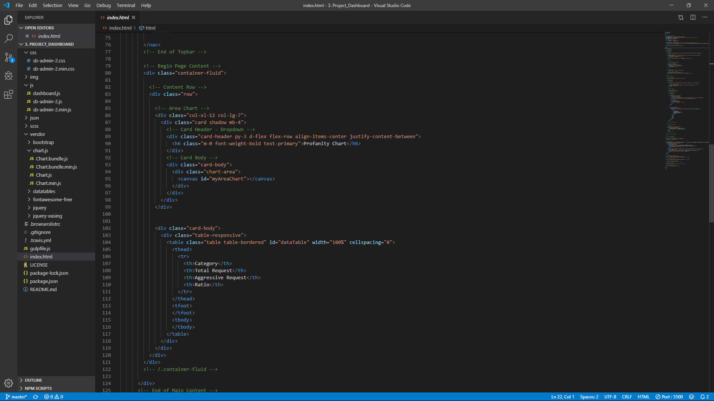
03 DEMONSTRATION

Slide 10
Thank you for attention
MADE IN JYN

